Slide 1
HOUSING: PRICE PREDICTION

Slide 2
Contents
Problem Statement
Introduction
Analytical Problem Framing
Models Development and Evaluation
Conclusion

Slide 3
Problem Statement
Houses are one of the necessary need of each and every person around the globe and therefore housing and real estate market is one of the markets which is one of the major contributors in the world’s economy. It is a very large market and there are various companies working in the domain. Data science comes as a very important tool to solve problems in the domain to help the companies increase their overall revenue, profits, improving their marketing strategies and focusing on changing trends in house sales and purchases. Predictive modelling, Market mix modelling, recommendation systems are some of the machine learning techniques used for achieving the business goals for housing companies. Our problem is related to one such housing company. A US-based housing company named Surprise Housing has decided to enter the Australian market. The company uses data analytics to purchase houses at a price below their actual values and flip them at a higher price. For the same purpose, the company has collected a data set from the sale of houses in Australia. The data is provided in the CSV file below. The company is looking at prospective properties to buy houses to enter the market.
You are required to build a model using Machine Learning in order to predict the actual value of the prospective properties and decide whether to invest in them or not. For this company wants to know:
• Which variables are important to predict the price of variable?
• How do these variables describe the price of the house?

Slide 4
INTRODUCTION
Business Problem Framing
To implement model we required to model the price of houses with the available independent variables. This model will then be used by the management to understand how exactly the prices vary with the variables. They can accordingly manipulate the strategy of the firm and concentrate on areas that will yield high returns. Further, the model will be a good way for the management to understand the pricing dynamics of a new market.
Conceptual Background of the Domain Problem
Create an effective price prediction model.
Validate the model’s prediction accuracy.
Identify the important home price attributes which feed the model’s predictive power.

Slide 5
Analytical Problem Framing
Data Preprocessing Done
1.Data Exploration
2.Data cleaning
3.Data Visualization
4.Feature Selection
5.Build model

Slide 6
Hardware and Software Requirements and Tools Used
Python was the major technology used for the implementation of machine learning concepts the reason being that there are numerous inbuilt methods in the form of packaged libraries present in python. Following are prominent libraries/tools we used in our project.
1)NUMPY
NumPy is a general-purpose array-processing package. it provides a high-performance multidimensional array object and tools for working with these arrays. It is the fundamental package for scientific computing with Python. Besides its obvious scientific uses, NumPy can also be used as an efficient multi-dimensional container of generic data.
Arbitrary data-types can be defined using Numpy which allows NumPy to seamlessly and speedily integrate with a wide variety of databases.
2)JUPYTER NOTEBOOK
The Jupyter Notebook is an open-source web application that allows you to create and share documents that contain live code, equations, visualizations, and narrative text. It includes data cleaning and transformation, numerical simulation, statistical modeling, data visualization, machine learning, and much more.

Slide 7
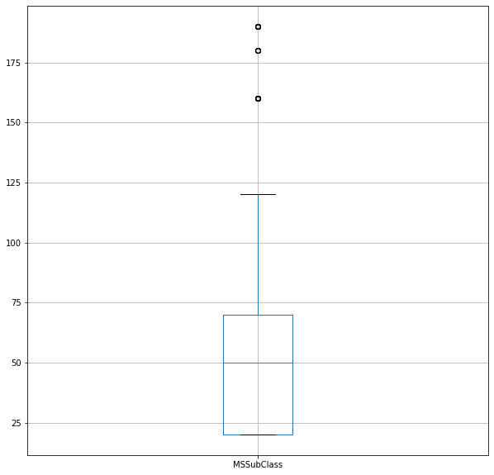
Models Development and Evaluation
Basic Stats
describe() shows a summary of numerial features, which can be visualized using boxplots and histograms. value_counts() can be used to generate a summary of categorical features

Slide 8
Do the data make sence? scan each column and see whether the data make sense at a high level.
longitude, latitude and house median age seem to be OK.
total rooms and total bedrooms are in hundreds and thousands - this does make sense given each row is a district
population seems to be OK but you want to know what's the unit for the number, e.g., thousands? millions? households are numbers of people living together, which is OK. Households mean is 499 and population mean is 1425, so you can tell that population is just the total number of people in each district not in thousands or millions.
median income is apparently problematic - how can mean income be 3.87? Actually, this is because median income has been scaled and capped between 15.0001 (max) and 0.4999 (min). Preprocessed attributes like this are common. Knowning how the data is calculated is critical.
median house value data is OK and this is our target variable, i.e., we want to build a model to predict this value.
Feature scaling: you have noticed that the features have very different scales, which we need to handle later
Distribution: from the histograms, we can tell many of them are skewed, i.e., having a long tail on one side or the other. In many cases, we need to transform the data so that they have more bell-shaped distributions.

Slide 9
Data Exploration
Data exploration is the first step in data analysis and typically involves summarizing the main characteristics of a data set, including its size, accuracy, initial patterns in the data and other attributes. It is commonly conducted by data analysts using visual analytics tools, but it can also be done in more advanced statistical software, Python. Before it can conduct analysis on data collected by multiple data sources and stored in data warehouses, an organization must know how many cases are in a data set, what variables are included, how many missing values there are and what general hypotheses the data is likely to support. An initial exploration of the data set can help answer these questions by familiarizing analysts with the data with which they are working.
Data Visualization
Data visualization is the graphical representation of information and data. By using visual elements like charts, graphs, and maps, data visualization tools provide an accessible way to see and understand trends, outliers, and patterns in data. In the world of Big Data, data visualization tools and technologies are essential to analyse massive amounts of information and make data-driven decisions.

Slide 10
Conclusion
The accurate prediction model would allow investors or house buyers to determine the realistic price of a house as well as the house developers to decide the affordable house price. This paper addressed the attributes used by previous researchers to forecast a house price using various prediction models.
These models were developed based on several input attributes and they work significantly positive with house price. In conclusion, the impact of this research was intended to help and assist other researchers in developing a real model which can easily and accurately predict
house prices. Further work on a real model needs to be done with the utilization of our findings to confirm them.

